Slide 1
Infection Network
18-100 Youngwoon Cheong

Slide 2
Table of Contents
Defining Infection network
SII Model
SEIR / SEIRS Model
SI3D Model (+parameters)
Play with the network
Experiment 1: Social distancing
Experiment 2: Personal Hygiene
What we can know from this

Slide 3
Defining Infection Network
Youngwoon Cheong

Slide 4
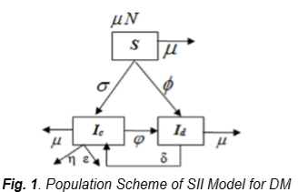
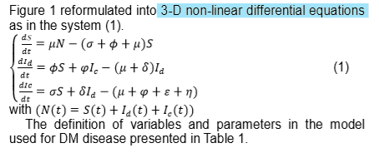
Infection Networks that I refer
SII Model
Reference: Used for analyzing Diabetes[1]
Not what I was looking for – It doesn’t consider infection! (Diabetes infection=???)
Still It well describes entire population’s status in the differential eq.

Slide 5
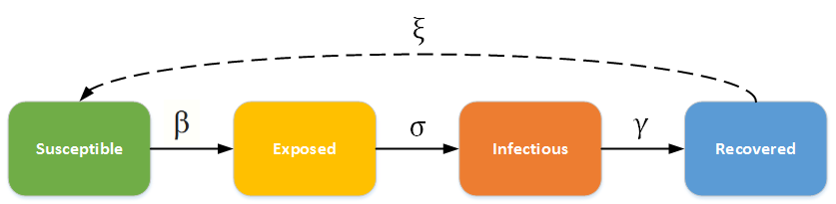
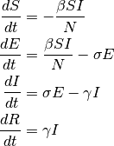
Infection Networks that I refer
SEIR / SEIRS Model
Reference: Used for infectible but not infectious diseases (e.g. chicken pox)[2]
SERIS considers infection and immune people(recovered), and also incubation period(exposed)!
Still, there are no death in the model(Because in the article, they considers only endemic diseases)

Slide 6
Quick Thought: What I should make?
Differential eq. models are quite good, but NOT FITS into my system(they are the graph, not a number)
So, slight modification of SEIRS from D.E. to discrete models are feasible.
Also we should add death in the model.
Vital dynamics? We don’t need it.

Slide 7
SI3D Model
Build a model for these situations
Infectious, lethal, and immune
And It must be consider every individual’s state

Slide 8
SI3D Model
SI3D: Susceptible, Incubated, Infected, Immune, Dead
Every individual’s state transit by certain probability
Most importantly, the infection probability determined by adjacent infected people. The more your friends infected, the more likely you will.
So what parameters would determine the system uniquely?
S
I_{C}
I_{F}
I_{M}
D

Slide 9



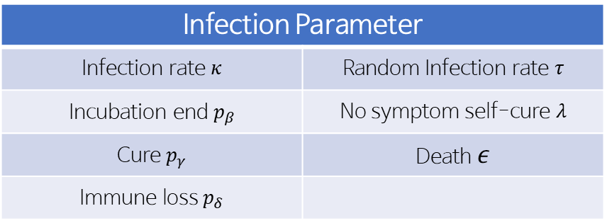


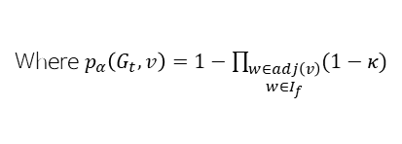

Parameters
Infection Parameter
Infection rate $κ$ | Random Infection rate $τ$
Incubation end $p_{β}$ | No symptom self-cure $λ$
Cure $p_{γ}$ | Death $ε$
Immune loss $p_{δ}$
Social Parameter
Connection rate | Population size
Patient zero count | (Simulation date)
$$p_{δ}$$
S
$$p_{α}\left(G_{t},v\right)+τ$$
I_{C}
$$p_{β}$$
I_{F}
$$p_{γ}$$
I_{M}
$$λ$$
Where $p_{α}\left(G_{t},v\right)=1−\prod_{\begin{aligned}w∈adj\left(v\right) \\ w∈I_{f}\end{aligned}}^{ }{(1−κ)}$
$$ε$$
D

Slide 10
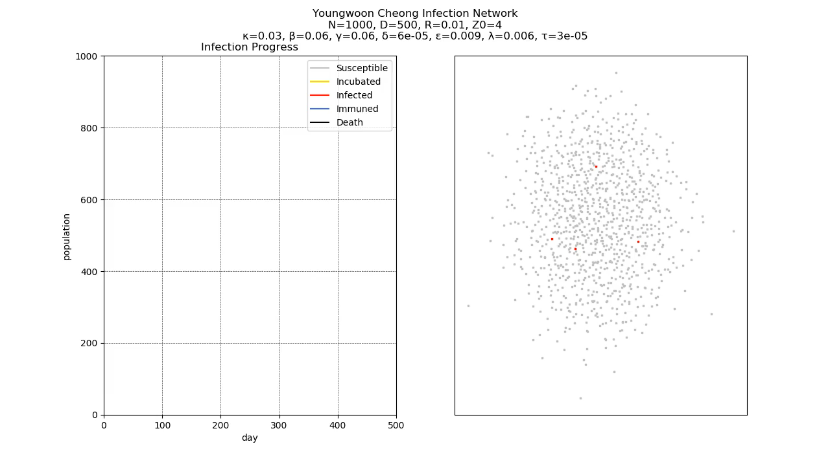
Result

Slide 11
Socially Stable State
In the observation, after the number of immune people passes highest point, the pandemic gets ‘stopped’.
So we can say that the SSS is the point when the number of immune people are local maximum and the highest.
Notice: There might be no SSS. We will see the example in later.

Slide 12
Playing with the network
Youngwoon Cheong

Slide 13
Experiment 1: Social Distancing
How effective is social distancing?
We can try experiment via controlling connection rate R
In a 1,000 population society, I tried experiment by controlling R as below.
R value | 0.03 | 0.025 | 0.02 | 0.015 | 0.01 | 0.005
Avg con. | 30 | 25 | 20 | 15 | 10 | 5
Other values are Control variables

Slide 14
Values that I used in the exp.
Population | Exp. Period | Connection Rate
Population | Exp. Period | Connection Rate | Patient Zero | Kappa (κ)
1,000 people | 300 days | Independent var. | 4 people | 0.03
Beta (β) | Gamma (γ) | Delta (δ) | Epsilon (ε) | Lambda (λ) | Tau (τ)
0.06 | 0.06 | 0.00006 | 0.009 | 0.006 | 0.0003
Connection Rate | 0.03 | 0.025 | 0.02 | 0.015 | 0.01 | 0.005
Average connections | 30 | 25 | 20 | 15 | 10 | 5

Slide 15
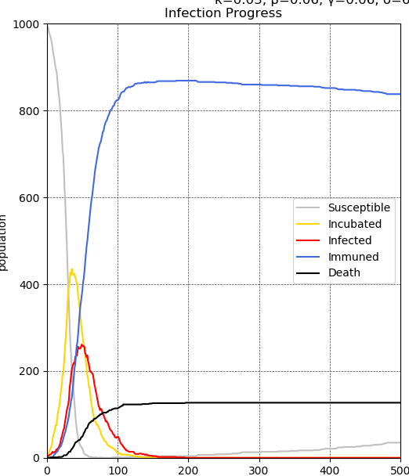
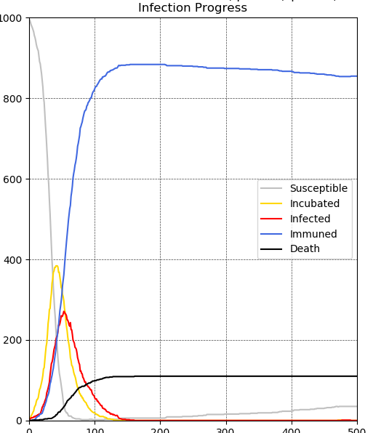
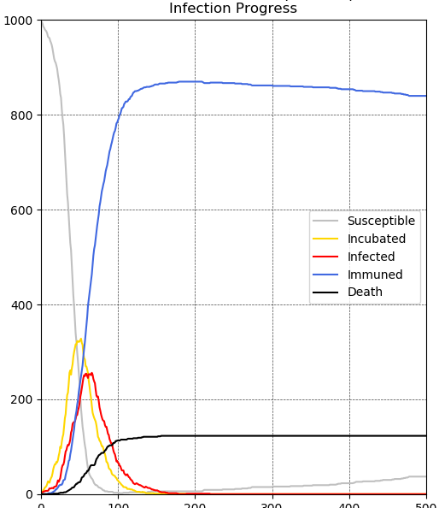
Results (1)
NR=30 | NR=25 | NR=20
* NR = N * R = Average connection

Slide 16
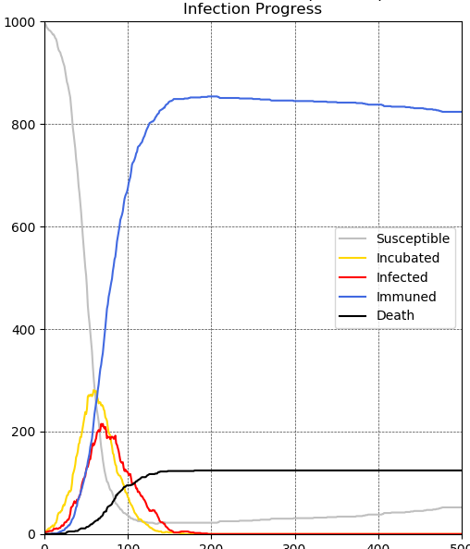
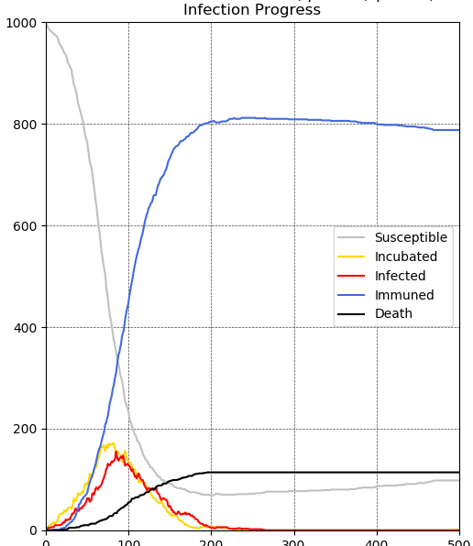
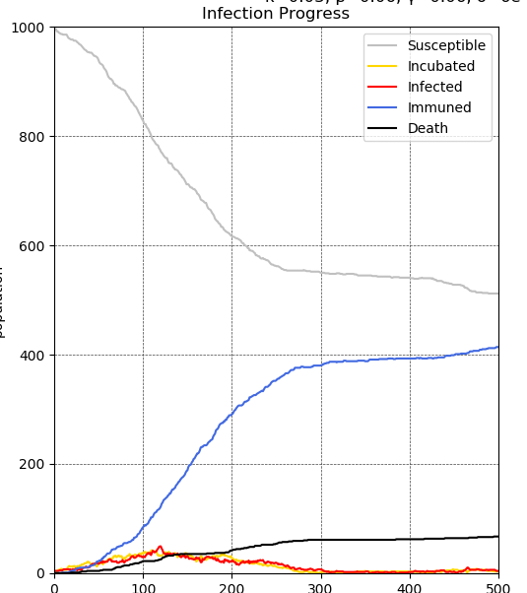
Results (2)
NR=15 | NR=10 | NR=5
* NR = N * R = Average connection

Slide 17
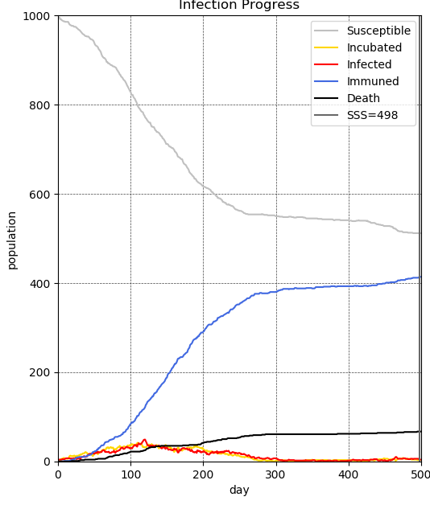

Conclusion
Social distancing is effective in significantly low NR values
Not only very low NR values, but there are still effects of decreasing peak numbers of patients
Peak numbers are important because there are threshold of medical services
While time of social distancing it is hard to reach SSS.
NR=30 | NR=5

Slide 18
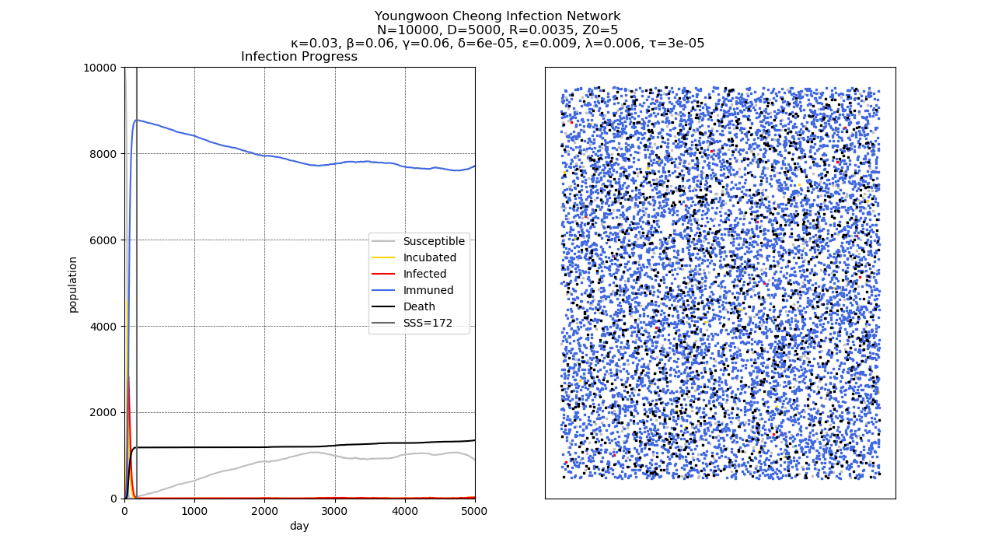
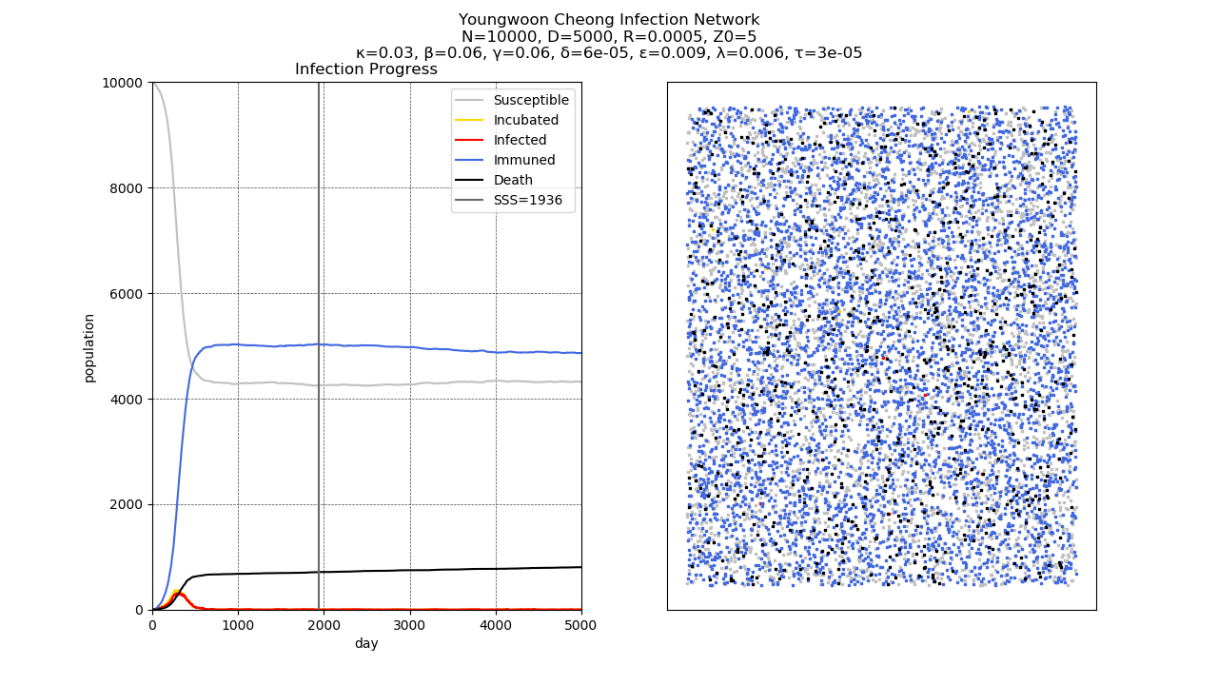
TMI: Also working on larger population

Slide 19
Thank you!
Any Questions?

